Slide 1
Lecture 4 Machine Learning Basic
Jaeyun Kang

Slide 2
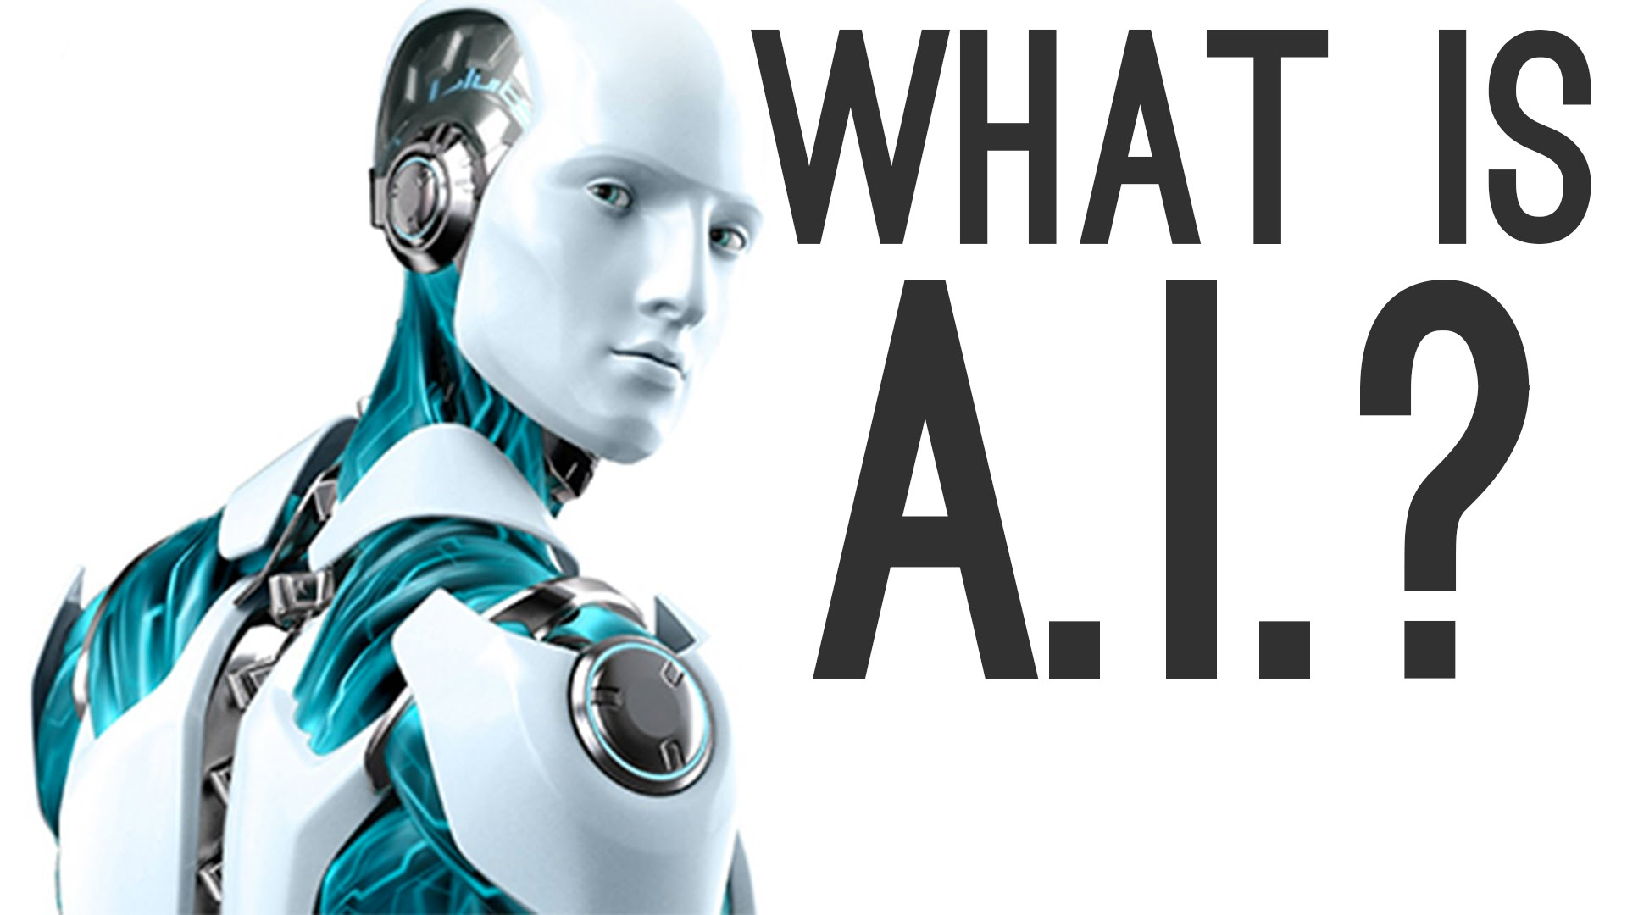
Aritificial Intelligence

Slide 3

Aritificial Intelligence
A.I. ?
“인간같이 생각하고 판단할 수 있는 컴퓨터”
그러나 컴퓨터는
기본적으로..

Slide 4

Aritificial Intelligence
A.I. ?
“인간같이 생각하고 판단할 수 있는 컴퓨터”
그러나 컴퓨터는
기본적으로..
인간에 비해 높은 연산능력
복잡한 계산을 빠르게 처리

Slide 5
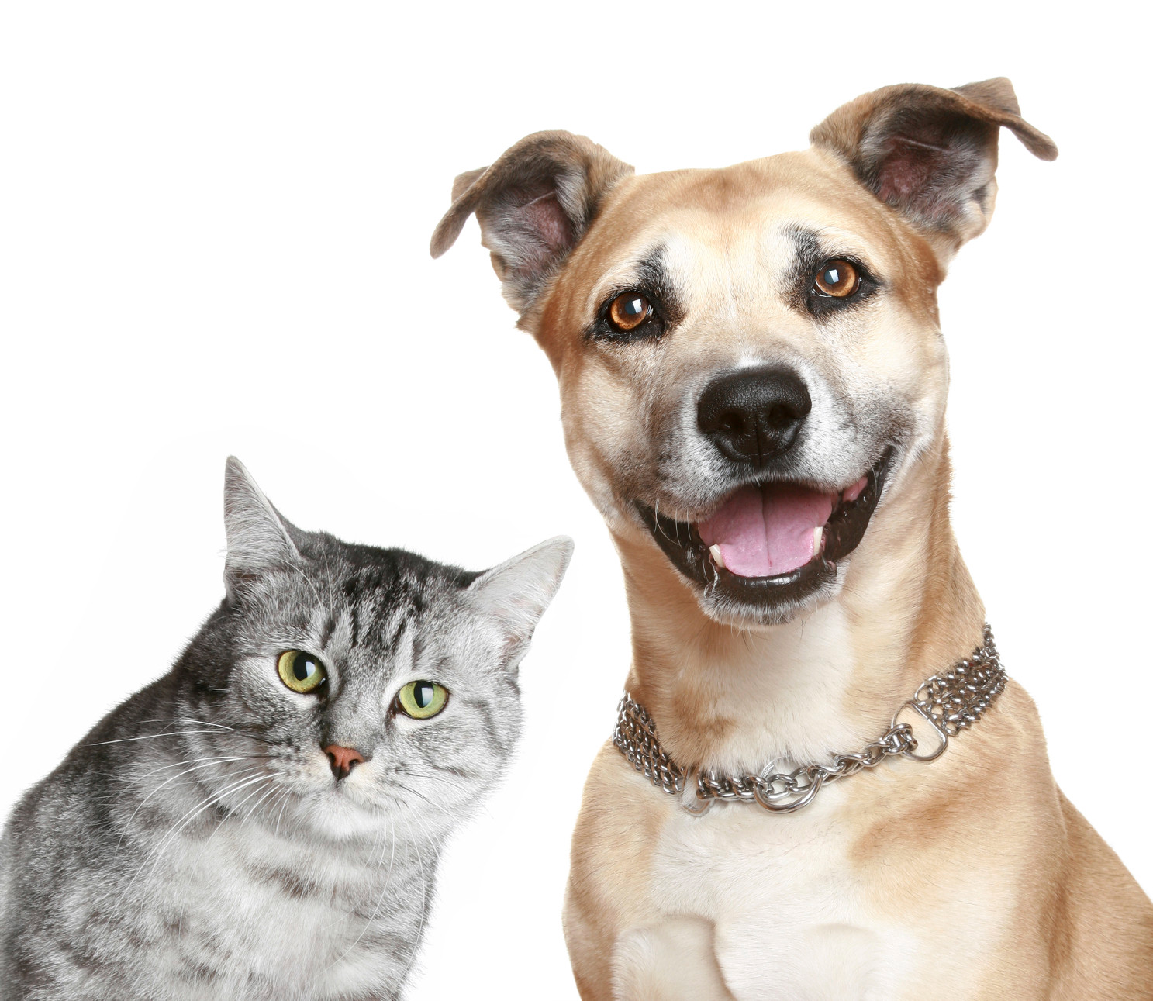
Aritificial Intelligence
A.I. ?
“인간같이 생각하고 판단할 수 있는 컴퓨터”
그러나 컴퓨터는
기본적으로..
인간에 비해 높은 연산능력
복잡한 계산을 빠르게 처리
인간에 비해 낮은 인지능력
개와 고양이 구분도 못한다!

Slide 6
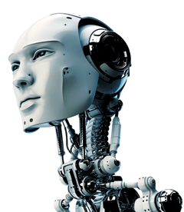
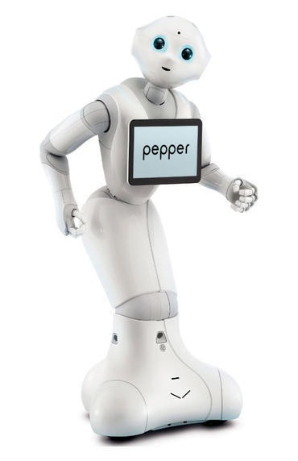
Aritificial Intelligence
아직 갈 길이 먼 A.I.
이상
현실

Slide 7
과거의 AI: Rule-Based AI
개 | 고양이
귀가 쳐져있다 | 귀가 뾰족하다
눈매가 착하다 | 눈매가 매섭다
덩치가 크다 | 덩치가 작다
컴퓨터가 개와 고양이 사진을 구분하기 위해 필요한
‘규칙’ 혹은 ‘패턴’을 직접 제시!

Slide 8
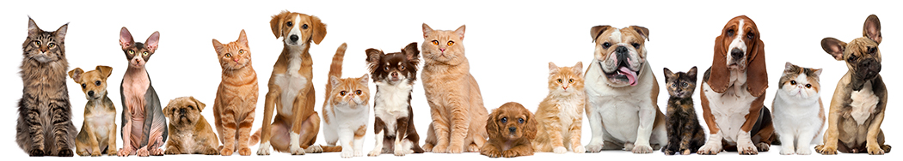
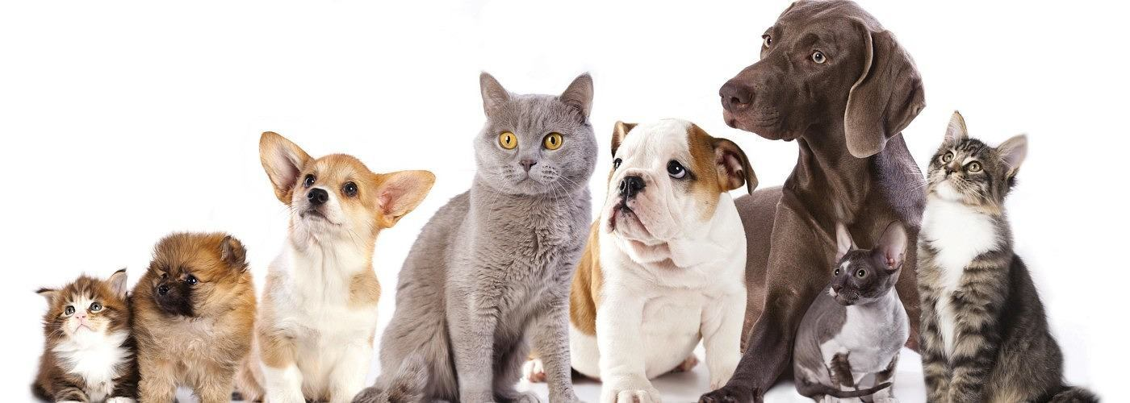
과거의 AI: Rule-Based AI

Slide 9
과거의 AI: Rule-Based AI
눈매가 착하다? 매섭다?
덩치가 작다? 크다?
귀가 뾰족하다? 쳐져있다?

Slide 10
과거의 AI: Rule-Based AI
Rule-Based AI의 한계: 모든 규칙을 우리가 직접 정해줄 수 없다!

Slide 11
과거의 AI: Rule-Based AI
컴퓨터에게 수 많은 개와 고양이 사진을 보여주고
컴퓨터 스스로 그 규칙을 찾아나가게 하자!
Data-Based AI

Slide 12

현재의 AI: Data-Based AI
‘데이터’를 많이 제공하여 컴퓨터가 ‘스스로’ 규칙을 배우도록 하자
Data-Based AI

Slide 13
현재의 AI: Data-Based AI
‘데이터’를 많이 제공하여 컴퓨터가 ‘스스로’ 규칙을 배우도록 하자
Data-Based AI = Machine Learning

Slide 14
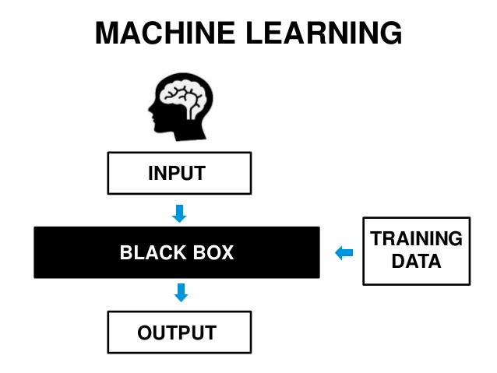
Machine Learning 의 원리
http://www.slideshare.net/AlexPoon1

Slide 15
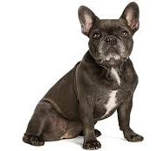
Machine Learning 의 원리
http://www.slideshare.net/AlexPoon1
목표: 개와 고양이를 구분하는 A.I. Black Box!

Slide 16
Machine Learning 의 원리
Cat!!

Slide 17
Machine Learning 의 원리
Cat!!
문제: Black Box가 개와 고양이를 구분하는 ‘규칙’을 알지 못한다!

Slide 18
Machine Learning 의 원리
Cat!!
해결: Data를 통해 Black Box를 학습시켜 올바른 ‘규칙’을 찾도록 만들자!

Slide 19
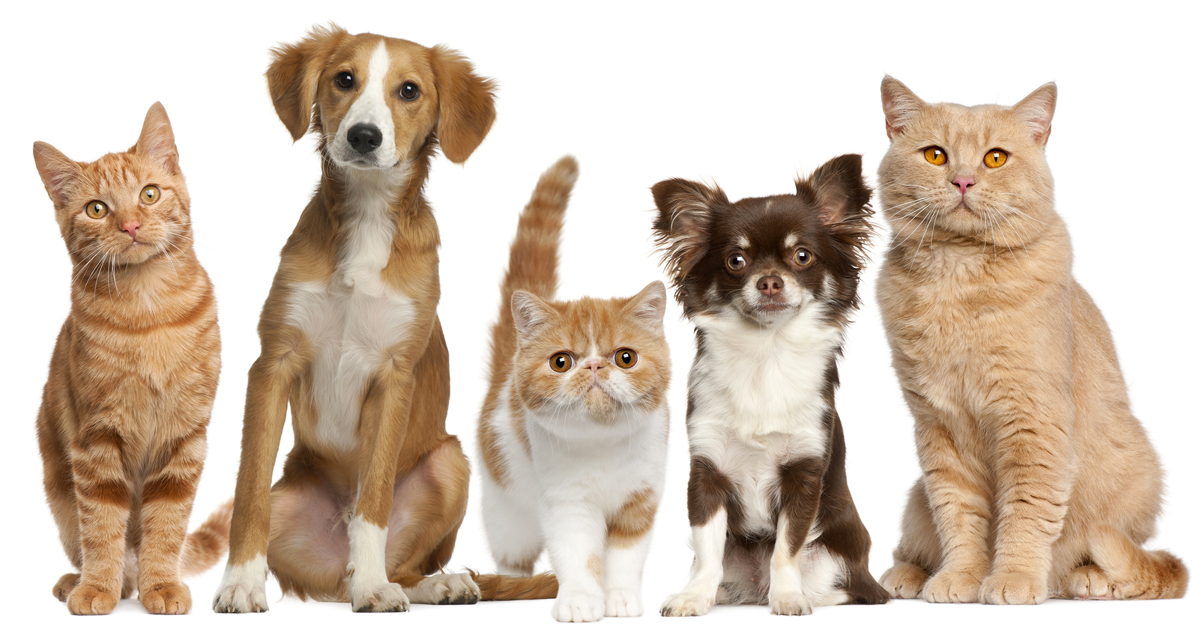
Machine Learning 의 원리
DATA and Label
cat dog cat dog cat
cat dog cat cat dog

Slide 20
Machine Learning 의 원리
DATA and Label
cat dog cat dog cat
cat dog cat cat dog
two wrong!

Slide 21
Machine Learning 의 원리
DATA and Label
cat dog cat dog cat
cat dog cat cat dog
one wrong!
Black Box 내부에서 개와 고양이를 판단하는 규칙을 수정한다

Slide 22
Machine Learning 의 원리
DATA and Label
cat dog cat dog cat
cat dog cat dog dog
one wrong!
Black Box 내부에서 개와 고양이를 판단하는 규칙을 ‘계속’ 수정한다

Slide 23
Machine Learning 의 원리
DATA and Label
cat dog cat dog cat
cat dog cat dog dog
two wrong!
Black Box 내부에서 개와 고양이를 판단하는 규칙을 수정한다

Slide 24
Machine Learning 의 원리
DATA and Label
cat dog cat dog cat
cat dog cat dog cat
right answer!
Black Box 는 학습을 마쳤다!

Slide 25
Machine Learning 의 원리
Dog!!
학습한 내용을 바탕으로 올바른 판단을 내릴 수 있게 되었다!

Slide 26
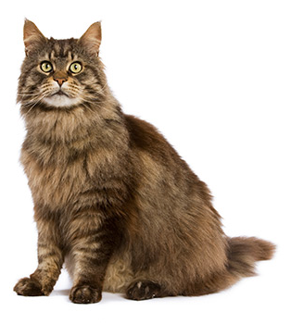
Machine Learning 의 원리
Cat!!
학습한 내용을 바탕으로 올바른 판단을 내릴 수 있게 되었다!

Slide 27
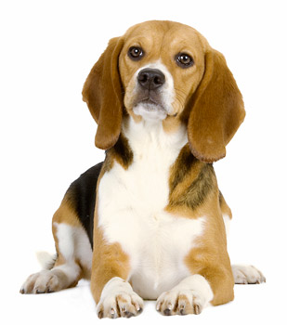
Machine Learning 의 원리
Dog!!
학습한 내용을 바탕으로 올바른 판단을 내릴 수 있게 되었다!

Slide 28
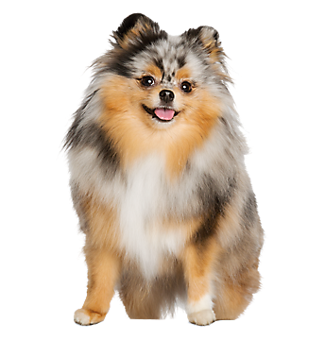
Machine Learning 의 원리
Cat??
어떠한 사진은 제대로 판단하지 못할 수 있다!
완전히 강아지와 고양이를 구분하는 규칙을 파악하지 못한 것

Slide 29
Machine Learning 의 원리
Cat??
모든 강아지와 고양이를 완전하게 구분하는 규칙을 찾기 위해서는?

Slide 30
Machine Learning 의 원리
DATA and Label
cat dog cat dog cat
cat dog cat cat dog
5마리의 개와 고양이 사진으로 모든 규칙을 학습 할 수 있나요?

Slide 31
Machine Learning 의 원리
DATA and Label
cat dog cat dog cat
cat dog cat cat dog
5마리의 개와 고양이 사진으로 모든 규칙을 학습 할 수 있나요?
NO

Slide 32
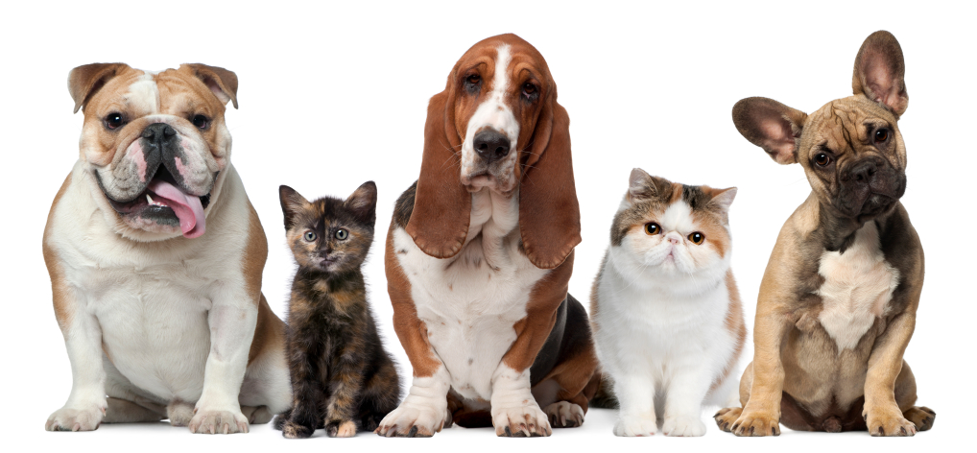
Machine Learning 과 Data
모든 규칙을 완전히 학습하기 위해서는 엄청나게 많은 훈련 Data가 필요

Slide 33
Machine Learning 과 Data
학습 데이터의 양이 많으면 많을 수록 정확도가 상승!

Slide 34
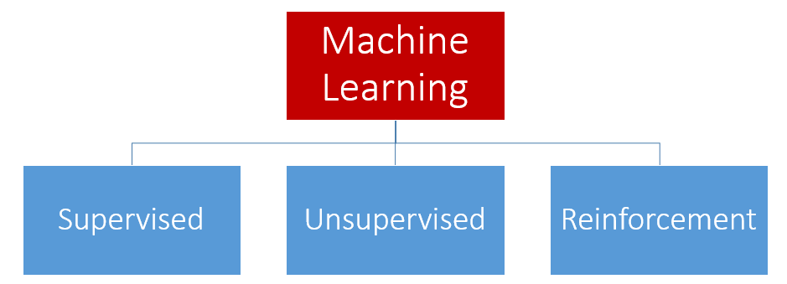
Three Types of Machine Learning

Slide 35

Supervised Learning
DATA and Label
cat dog cat dog cat
cat dog cat cat dog
Supervised Learning: Learning from labeled data

Slide 36
Supervised Learning
Supervised Learning: Learning from labeled data
Image Classification
cat dog cat dog cat
Data: Pictures Label: Classes

Slide 37
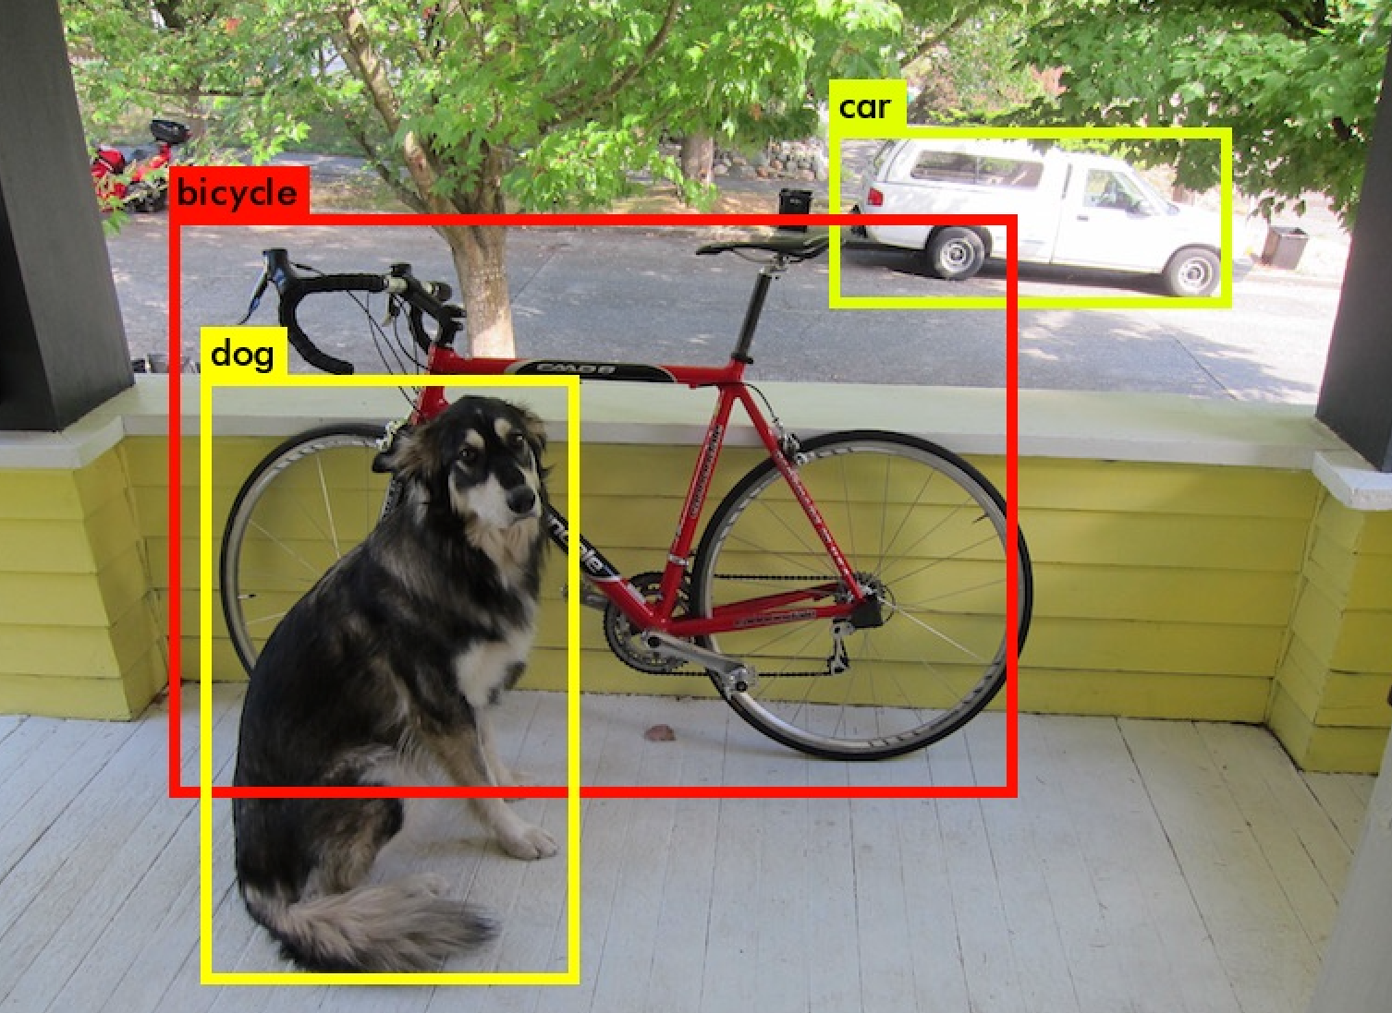
Supervised Learning
Supervised Learning: Learning from labeled data
Object Detection
Data: Pictures Label: Boxes & Classes

Slide 38
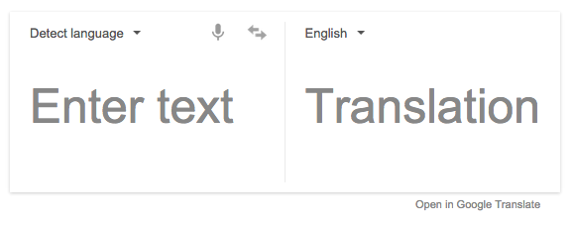

Supervised Learning
Supervised Learning: Learning from labeled data
Machine Translation
Data: 번역 이전의 문장 Label: 번연된 문장

Slide 39
Supervised Learning
Supervised Learning: Learning from labeled data
Machine Translation
Data: 번역 이전의 문장 Label: 번연된 문장
대부분의 Machine Learning 적용 사례는 Supervised Learning!

Slide 40
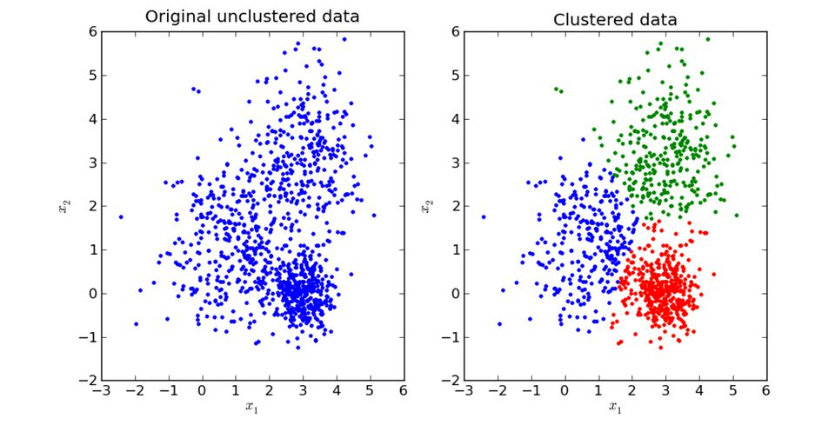
Supervised Learning
Unsupervised Learning: Learning from unlabeled data
Clustering

Slide 41
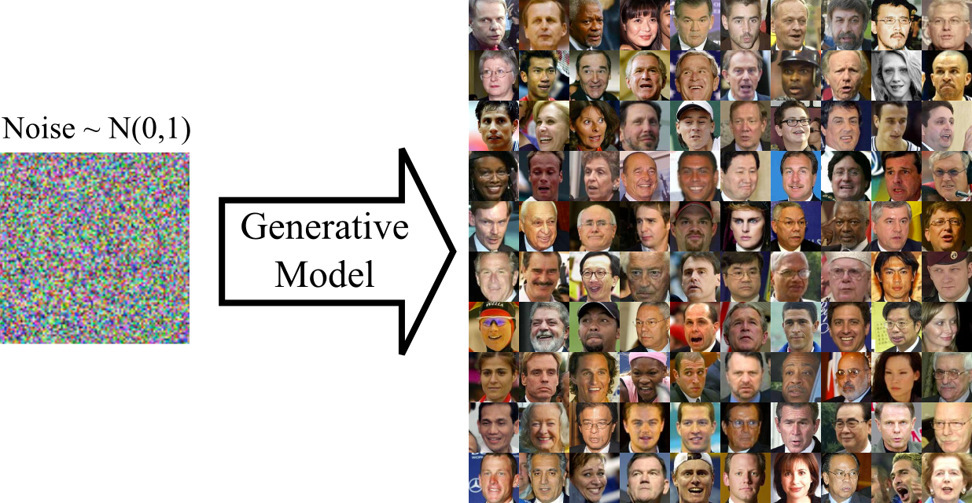
Supervised Learning
Unsupervised Learning: Learning from unlabeled data
Image Generation

Slide 42
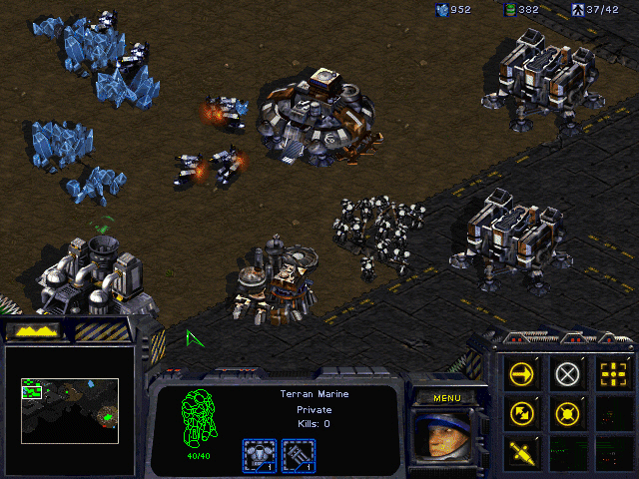
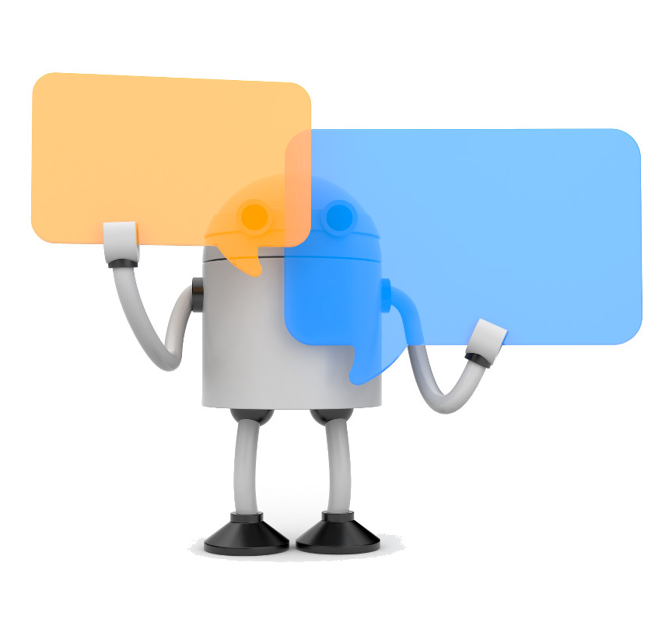
Reinforcement Learning
Reinforcement Learning: Evaluate after action
Game Play
Chatbot

Slide 43
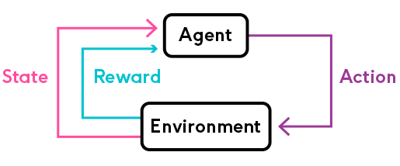
Reinforcement Learning
Reinforcement Learning: Evaluate after action
일단 Action을 취한 뒤 Reward를 받고 새로운 State를 가진다.
각 State에서 높은 Reward를 받을 수 있는 Action의 확률을 높인다!

Slide 44
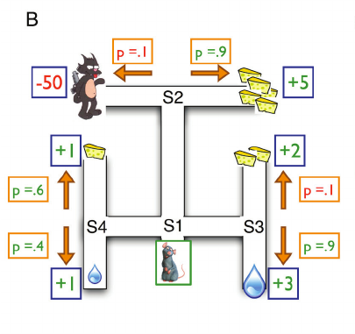
Reinforcement Learning
Reinforcement Learning: Evaluate after action
일단 Action을 취한 뒤 Reward를 받고 새로운 State를 가진다.
각 State에서 높은 Reward를 받을 수 있는 Action의 확률을 높인다!

Slide 45
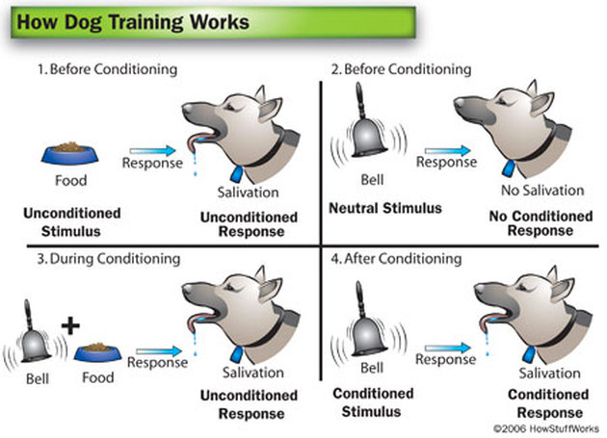
Reinforcement Learning
인간/동물의 학습방식과 가장 유사한 학습방식

Slide 46
Three Types of ML 비교
 | Supervised Learning | Unsupervised Learning | Reinforcement Learning
개념 | Learning from labeled data | Learning from unlabeled data | Evaluate after Action
적용 | Classification Object Detection Machine Translation … | Clustering Image Generation … | Game AI Chatbot System …
기타 | 대부분의 Machine Learning 사례 | - | 인간의 학습방식과 가장 유사
국문 | 지도학습 | 비지도학습 | 강화학습

Slide 47
Focus on Supervised Learning

Slide 48

Image Classification

Slide 49
Image Classification
DATA and Label
cat dog cat dog cat

Slide 50
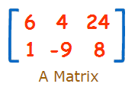
Image Classification
2 rows, 3 columns
2x3 matrix
For Image,
32x32 image is
32x32 matrix

Slide 51
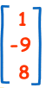
Linear Algebra
We call nx1 or 1xn matrix
“vector”
2 rows, 3 columns
2x3 matrix

Slide 52
Image Classification
vector
For Image,
32x32 image is
1024-size vector

Slide 53
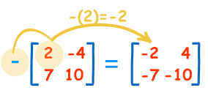
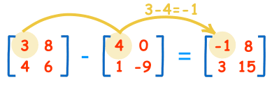
Linear Algebra
negative
subtracting
The two matrices must
be the same size,

Slide 54
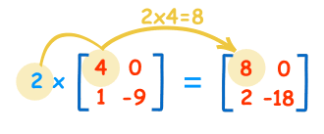
Linear Algebra
multiply by constant
We call the constant a scalar,
so officially this is called "scalar multiplication".

Slide 55
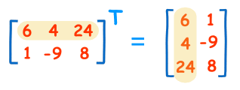
Linear Algebra
transposing
To "transpose" a matrix, swap the rows and columns.
We put a "T" in the top right-hand corner to mean transpose:

Slide 56
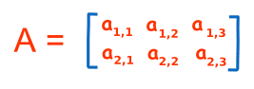
Linear Algebra
notation
Rows go left-right
Columns go up-down

Slide 57
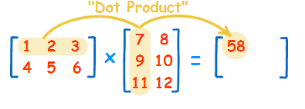
Linear Algebra
Matrix Multiplication
The "Dot Product" is where we multiply matching members, then sum up:
(1, 2, 3) · (7, 9, 11) = 1×7 + 2×9 + 3×11 = 58
AxB = C, ci,j is dot product of ith row of A and jth row of B

Slide 58
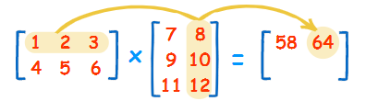
Linear Algebra
Matrix Multiplication
(1, 2, 3) · (8, 10, 12) = 1×8 + 2×10 + 3×12 = 64

Slide 59
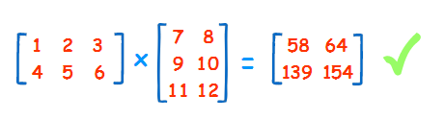
Linear Algebra
Matrix Multiplication
We can do the same thing for the 2nd row and 1st column:
(4, 5, 6) · (7, 9, 11) = 4×7 + 5×9 + 6×11 = 139
And for the 2nd row and 2nd column:
(4, 5, 6) · (8, 10, 12) = 4×8 + 5×10 + 6×12 = 154

Slide 60
Linear Algebra
Matrix Multiplication
A: 2x3 matrix, B: 3x2 matrix
C=AxB: 2x2 matrix
A: nxm, B: mxk
C=AxB: nxk matrix

Slide 61
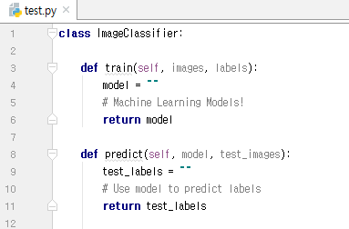
Image Classification
train the model
predict the label from
trained model!
or infer (inference)

Slide 62

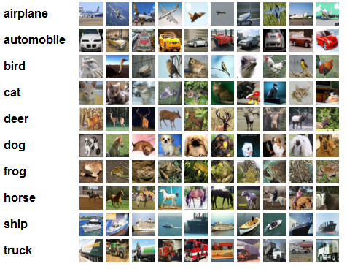
Popular & Simple Datasets
CIFAR10
32x32x3
MNIST
28x28x1

Slide 63
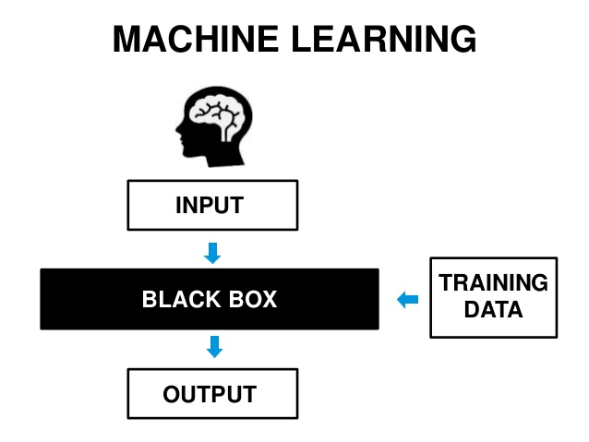
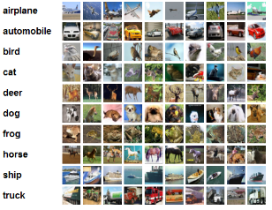
Image Classification with ML
train the model

Slide 64
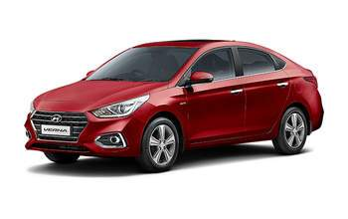
Image Classification with ML
predict the label from
trained model!
or infer (inference)

Slide 65
Image Classification with ML
Then,
What is model? (black box)

Slide 66
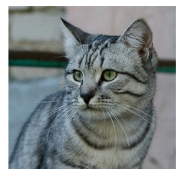
Linear Classifier
model is mathematical function!
Image
model
f(x, W)
10 numbers giving
class scores
W
parameters or weights
Array of 32x32x3 numbers
(3072 numbers total)

Slide 67
Linear Classifier
Linear Classifer
f(x, W) = Wx
Image
model
f(x, W)
10 numbers giving
class scores
W
parameters or weights
Array of 32x32x3 numbers
(3072 numbers total)

Slide 68
Linear Classifier
Linear Classifer
f(x, W) = Wx
Image
3072x1
vector
model
f(x, W)
10 numbers giving
class scores
W
parameters or weights
Array of 32x32x3 numbers
(3072 numbers total)

Slide 69
Linear Classifier
Linear Classifer
f(x, W) = Wx
Image
10x1
vector
3072x1
vector
model
f(x, W)
10 numbers giving
class scores
W
parameters or weights
Array of 32x32x3 numbers
(3072 numbers total)

Slide 70
Linear Classifier
Linear Classifer
f(x, W) = Wx
Image
10x1
vector
3072x1
vector
10x3072 matrix !
f(x, W)
10 numbers giving
class scores
W
parameters or weights
Array of 32x32x3 numbers
(3072 numbers total)

Slide 71
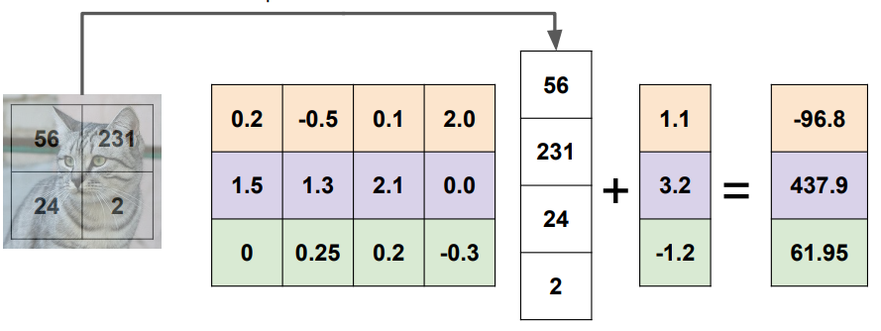
Linear Classifier (Simpler)
scores
Cat score
Dog score
Ship score
Input Image
W
weights, this should be changed during training
b
bias, also

Slide 72
Linear Classifier (Simpler)
scores
Cat score
Dog score
Ship score
Input Image
W
weights
b
bias

Slide 73
Linear Classifier (Simpler)
scores
Cat score
Dog score
Ship score
Input Image
W
weights
b
bias

Slide 74
Linear Classifier (Simpler)
scores
Cat score
Dog score
Ship score
Input Image
W
weights
b
bias

Slide 75
Linear Classifier (Simpler)
scores
Cat score
Dog score
Ship score
Input Image
W
weights
if it trained well, what each row vector means?
b
bias

Slide 76
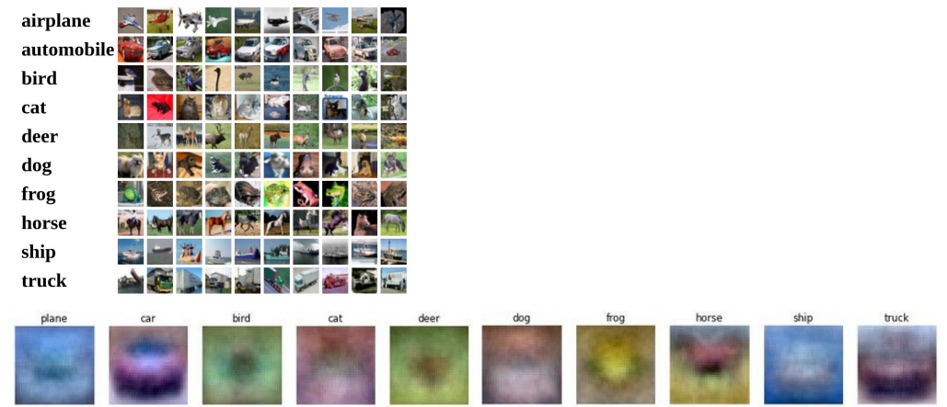
Interpreting a Linear Classifier
f(x, W) = Wx
Example trained weights of a
linear classifier trained on
CIFAR-10:

Slide 77
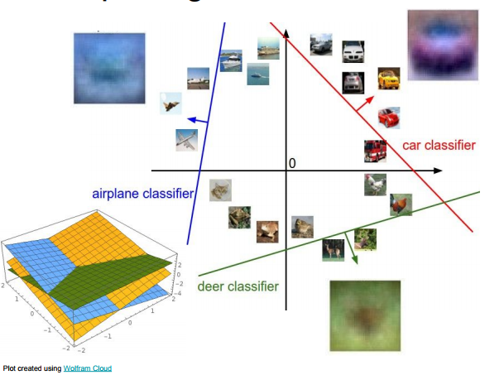
Interpreting a Linear Classifier
For simple
explanation,
assume x vector’s
size is 2
all images can be
located at 2-dim plane

Slide 78
Interpreting a Linear Classifier
Each line is
Wcx=0
where Wc is
each class’
row vector of W

Slide 79
Interpreting a Linear Classifier
Linear Classifier
means
the classifier which
can classify classes
by linear lines

Slide 80
Linear Classifier (Simpler)
scores
Cat score
Dog score
Ship score
Input Image
W
weights, this should be changed during training
Is it good score vector?

Slide 81
Linear Classifier (Simpler)
scores
Cat score
Dog score
Ship score
Input Image
W
weights, this should be changed during training
Is it good score vector?
how to we evaluate score?

Slide 82
Linear Classifier (Simpler)
scores
Cat score
Dog score
Ship score
Input Image
W
weights, this should be changed during training
Is it good score vector?
how to we evaluate score?
loss

Slide 83
Loss Function
loss function:
주어진 scores 와 answer(label)에 대하여
score가 얼마나 정답에 가까운지를 평가하는 함수
loss가 클 수록 잘못된 scores를 의미함!
대표적인 loss function 종류: Softmax, SVM

Slide 84
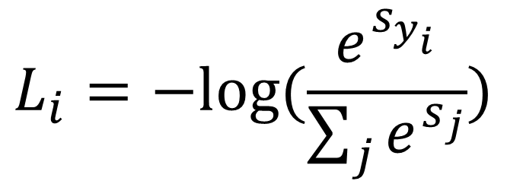
Loss Function
Softmax Loss
$$L_{i}=−log⁡(\frac{e^{s_{y_{i}}}}{\sum_{j}{e^{s_{j}}}})$$
?????????

Slide 85
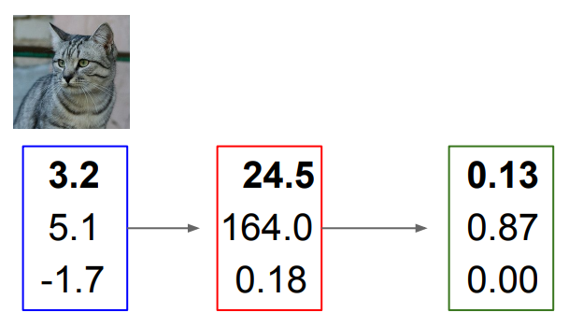
Loss Function
cat
car
frog
scores

Slide 86
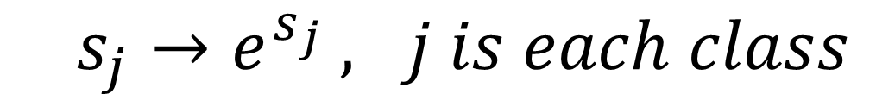
Loss Function
$s_{j}→e^{s_{j}} , j is each class$
cat
car
frog
scores
exponentiation

Slide 87
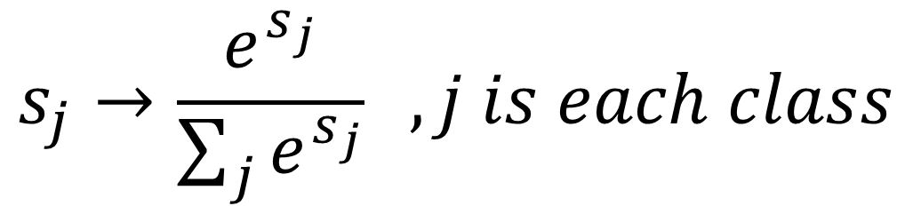
Loss Function
$$s_{j}→\frac{e^{s_{j}}}{\sum_{j}{e^{s_{j}}}} , j is each class$$
cat
car
frog
scores
exponentiation
normalization

Slide 88
Loss Function
$$s_{j}→\frac{e^{s_{j}}}{\sum_{j}{e^{s_{j}}}} , j is each class$$
cat
car
frog
= probability
scores
exponentiation
normalization

Slide 89
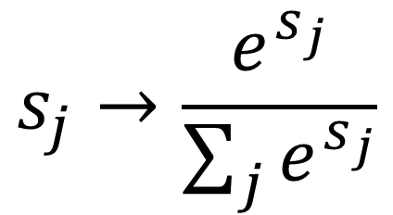
Loss Function
$$s_{j}→\frac{e^{s_{j}}}{\sum_{j}{e^{s_{j}}}}$$
softmax function
cat
car
frog
= probability
scores
exponentiation
normalization

Slide 90
Loss Function
$$s_{j}→\frac{e^{s_{j}}}{\sum_{j}{e^{s_{j}}}}$$
softmax function
#one hot encoding
cat
car
frog
1
0
0
scores
exponentiation
normalization
label

Slide 91
Loss Function
$$s_{j}→\frac{e^{s_{j}}}{\sum_{j}{e^{s_{j}}}}$$
if cat score goes to 1
loss goes to 0 (low)
if cat score goes to 0
loss goes to inf (high)
cat
car
frog
1
0
0
scores
exponentiation
normalization
label

Slide 92
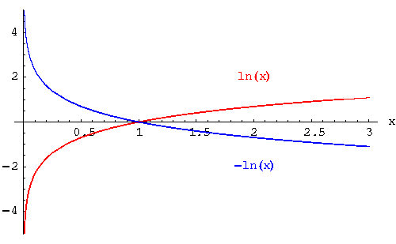
Loss Function

Slide 93
Loss Function
$$s_{j}→\frac{e^{s_{j}}}{\sum_{j}{e^{s_{j}}}}$$
loss
= -log(class score)
= -log(0.13)
cat
car
frog
1
0
0
scores
exponentiation
normalization
label

Slide 94
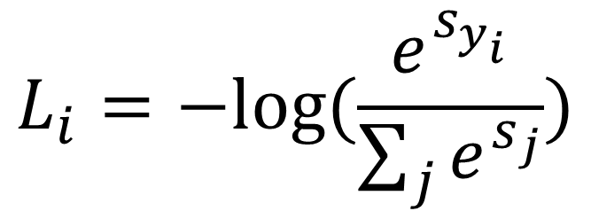
Loss Function
$$L_{i}=−log⁡(\frac{e^{s_{y_{i}}}}{\sum_{j}{e^{s_{j}}}})$$
cat
car
frog
1
0
0
scores
exponentiation
normalization
label

Slide 95
Loss Function
Image
model
f(x, W)
scores
loss
W
weights

Slide 96
How to minimize the loss?
Image
model
f(x, W)
scores
loss
W
weights

Slide 97
How to minimize the loss?
Image
model
f(x, W)
scores
loss
W
weights
how to find W
minimize the loss?

Slide 98

Gradient Descent Algorithm
# cost = loss

Slide 99
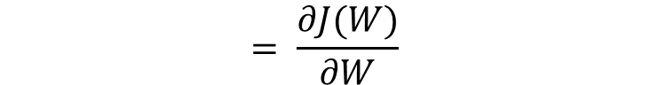
Gradient Descent Algorithm
$$= \frac{∂J(W)}{∂W}$$
# cost = loss

Slide 100

Gradient Descent Algorithm
$$= \frac{∂J(W)}{∂W}$$
$$W=W − α\frac{∂J\left(W\right)}{∂W}$$

Slide 101
Gradient Descent Algorithm
$$= \frac{∂J(W)}{∂W}$$
$$W=W − α\frac{∂J\left(W\right)}{∂W}$$
learning rate

Slide 102

Gradient Descent Algorithm
big learning rate
small learning rate
overshooting
too slow learning

Slide 103

Gradient Descent Algorithm
w is not scalar!
if w is 1x2 matrix
we have to change
2 weights

Slide 104

Gradient Descent Algorithm

Slide 105
Gradient Descent Algorithm
what if w is 6x7 matrix?
we cannot draw ☹
just for visualization,
we assume w has 2 or 1 dim

Slide 106

Tensorflow Installation

Slide 107

Tensorflow Installation
pip install tensorflow

Slide 108

Tensorflow Installation
pip install tensorflow

Slide 109


Tensorflow Basic

Slide 110


Tensorflow Basic
v2.7

Slide 111

Tensorflow Basic
v2.7

Slide 112


Tensorflow Basic
v2.7

Slide 113


Placeholder
v2.7

Slide 114


Placeholder
v2.7

Slide 115

Tensorflow Practice

Slide 116


Tensorflow Practice

Slide 117

Tensorflow Practice

Slide 118

Tensorflow Practice

Slide 119

Tensorflow Practice

Slide 120



Tensorflow Practice

Slide 121
Tensorflow Practice
training time vs prediction time ?
How about rule-based (algorithmic) classifier?
At service field, prediction(test) time is much more important!

Slide 122
Deep Learning Library
We can implement this with pure python code.
But.. did we compute softmax function ?
gradient ? optimization ?
all of these processes were done by tensorflow!
And.. There are other similar libraries!

Slide 123



Deep Learning Library

Slide 124



Deep Learning Library

Slide 125
Deep Learning Library

Slide 126
Question

